Slide 1
Working towards CIN-ergy
Kelly Brock
Fall Group Meeting#3 10/23/2015

Slide 2
General Updates
Working on abstract/poster for tetraploidy
Discuss new hire situation?
  Updated IT
  Brainstorming projects
Ask me about why it was good I left a little early last Friday . . . ☺

Slide 3
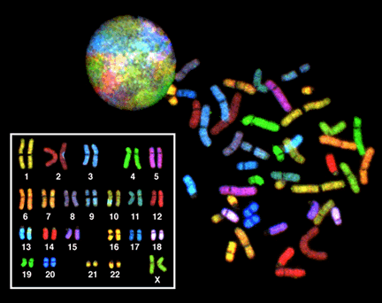
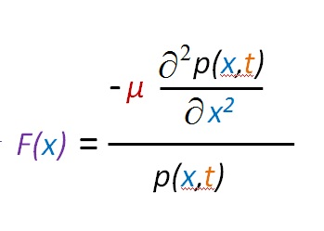
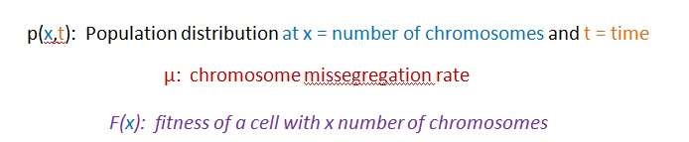
Recap: Obligate tetraploidy revealed through fitness landscapes
https://en.wikipedia.org/wiki/Karyotype
Our SKY data comes from GliNS2 cells, derived from a 54-year-old patient with glioblastoma multiforme

Slide 4
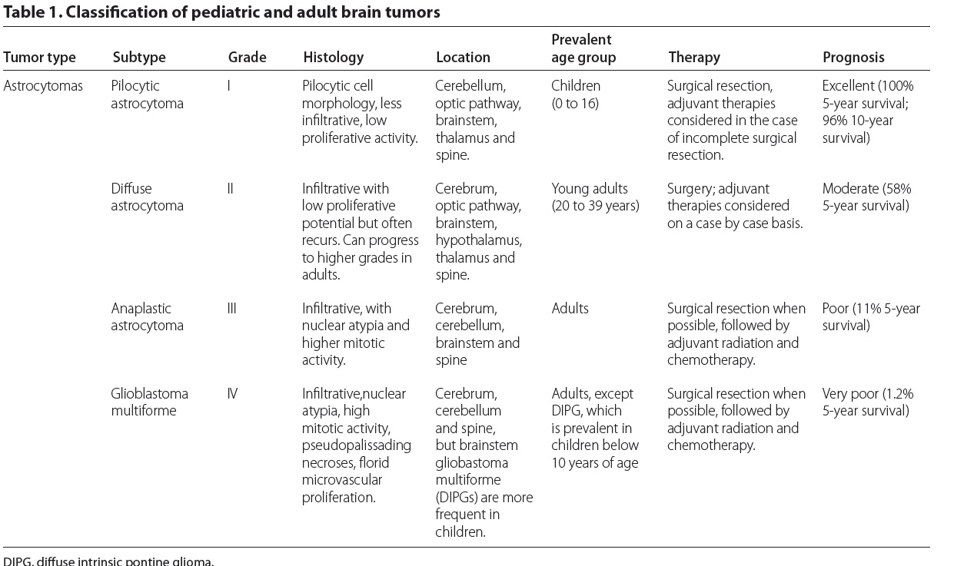
Connecting to clinical data - astrocytomas
Gerges et al. Genome Medicine 2013, 5:66

Slide 5
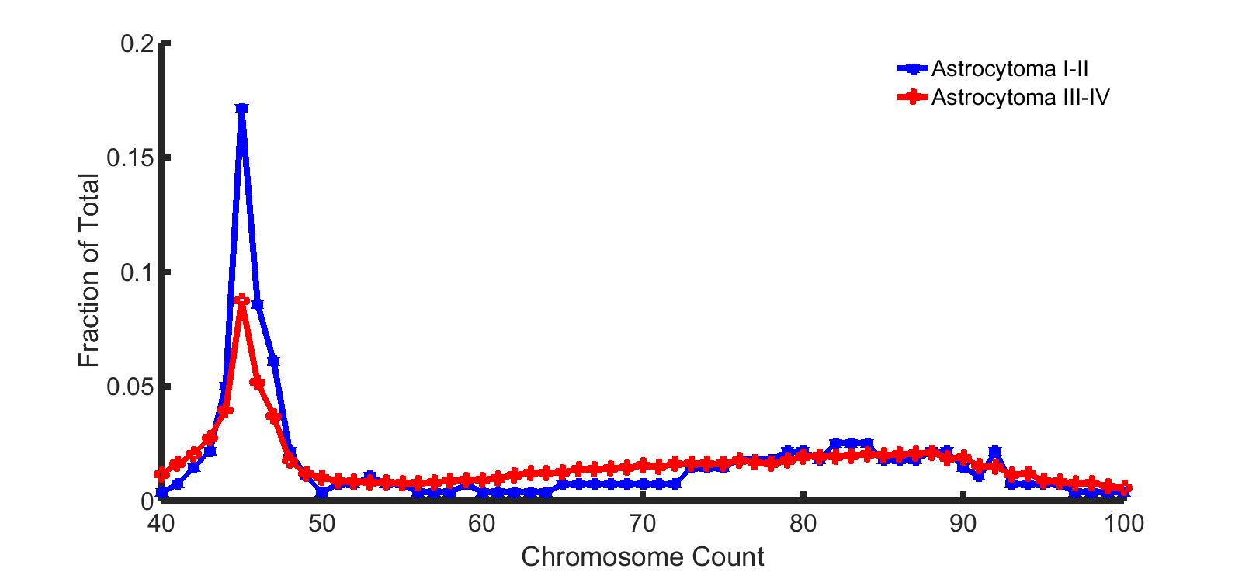
Astrocytomas have bimodal distributions influenced by prognosis

Slide 6
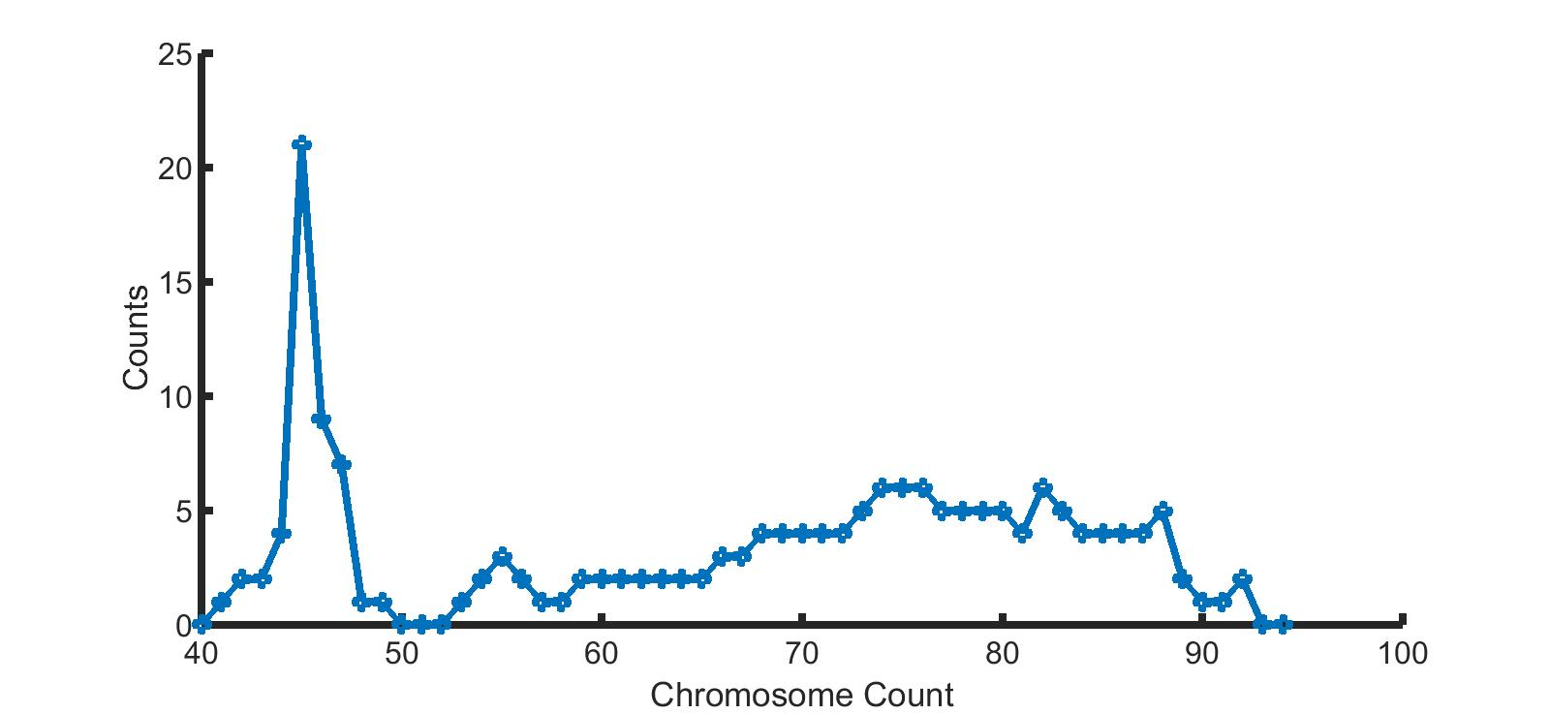
Glioblastoma NOS

Slide 7
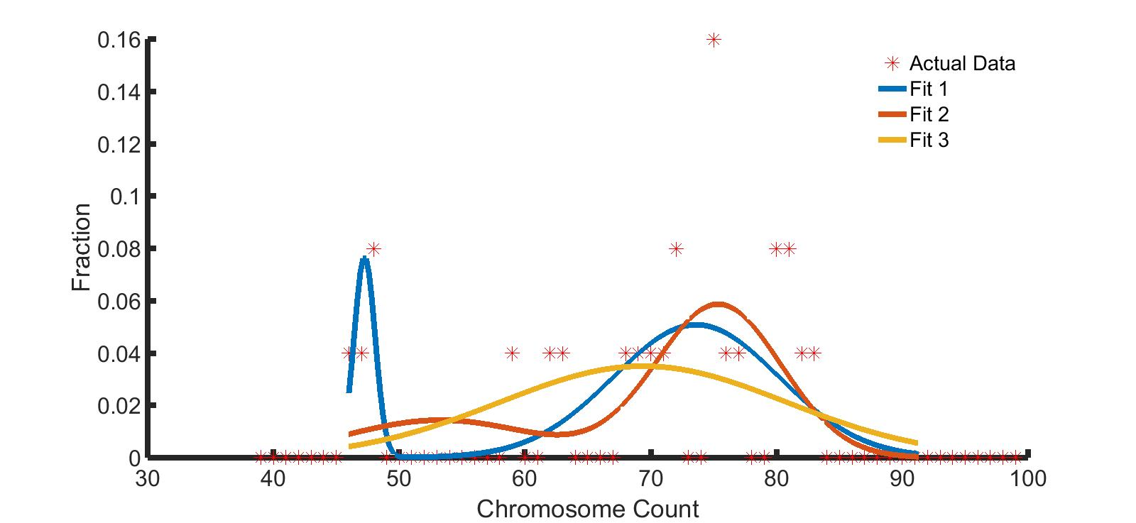
Parameter Sweep for Fit
99% give Fit 1 (least error) for 456 trials
  Other fits have difficulty w/ bimodality

Slide 8
Moving forward
CIN relevance
  Straw, back
  Heterogeneity worth pursuing?
Kolmogorov forward medium dive
Open questions around hiring

